Slide 1

Distress Brief Intervention (DBI)
Buzz Session
Connected Compassionate Support

Slide 2



Welcome
Introductions
What is DBI?
Making a referral
Local DBI Data/Case Study
Questions
Connected Compassionate Support

Slide 3

What is DBI?
The overarching aim of DBI is to improve co-ordination across agencies, facilitate quicker access to support and provide more consistency in the compassion people in distress receive.
“ask once, get help fast”
DBI is a 2-level response
Level 1: Enhancing the immediate frontline response to distress
Level 2: Enhancing immediate follow-up/support (24hrs – 14 consecutive days)
Connected Compassionate Support

Slide 4

What is DBI?
DBI Level 1
Simple caring and compassionate response provided by frontline staff at point of initial distress presentation
Conversation & assessment with a person in distress or suspected to be in distress
Option to refer those eligible to receive further support within 24 hrs
DBI Level 2
Within 24 hours DBI Practitioners attempt contact with person in distress to engage and offer support
Available 7 days a week, providing compassionate, person-centred support for up to 14 consecutive days:
  Empathic needs focussed assessment
  Problem-solving and self-management skills
  Signposting, information about specialist services & local support options
  Development of a distress management plan
Referral
Connected Compassionate Support

Slide 5
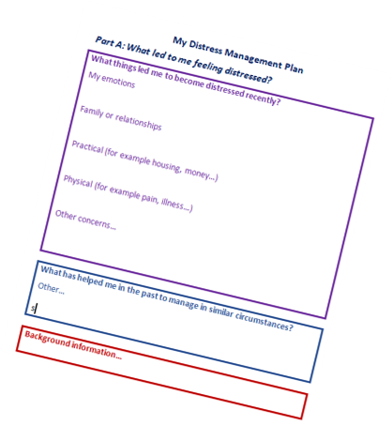
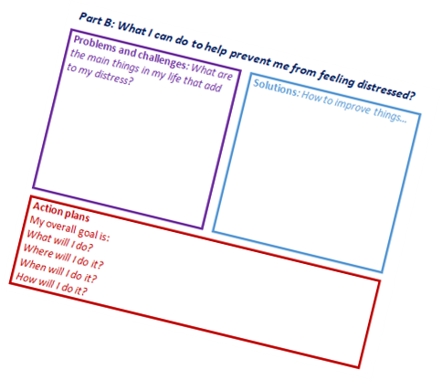
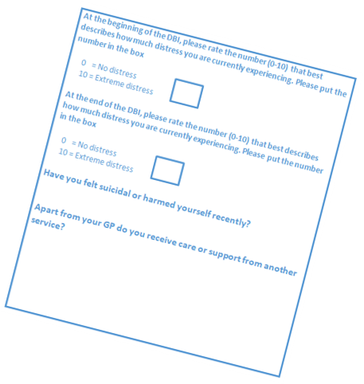
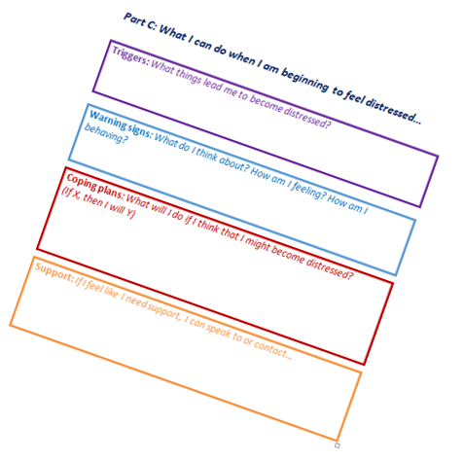
What is DBI?
A core and mandatory component of DBI Level 2. The D-MaP is a resource for identifying and recording the experiences, expectations, strengths and concerns of a person in distress

Slide 6
Referral Criteria
Who is DBI for?
Who is DBI not for?
Individuals (16+) with emotional pain for which they sought, or were referred for, help and which does not require (further) emergency response.
DBI is suitable for individuals encountering frontline services with a wide range of distress presentations.
Anyone in distress who requires urgent treatment or assessment of physical or mental health
Anyone under 16 years of age
An additional option
DBI is an additional option available to manage the high number of distress presentations
DBI does not replace existing pathways for care, treatment or support.
Connected Compassionate Support

Slide 7
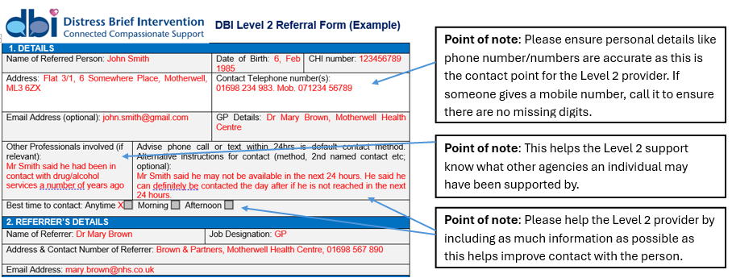
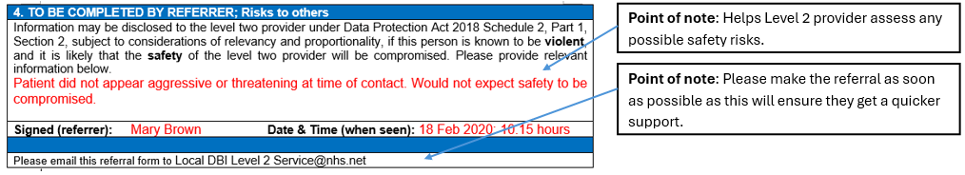
Referral information

Slide 8
Local service data
Local services statistics can be added here…
Connected Compassionate Support

Slide 9
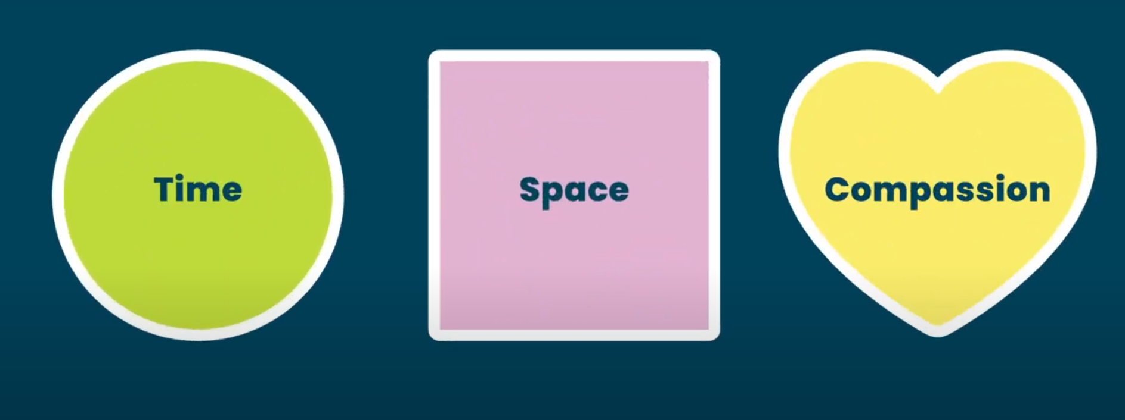
Time Space Compassion – Helen’s Story
Connected Compassionate Support
Notes:
Facilitator to insert local case study:
What were the presenting problems when this person was referred to DBI Level 2?
What were the desired outcomes identified by the person in distress?
Outline the steps taken by the person in distress, supported by the DBI practitioner, that have helped manage their distress in the short and longer term.
Alternatively, the time space compassion composite story can be played here.

Slide 10


Q
A
*these resources are based on the good practice of buzz sessions across Scotland, including organisations SAMH, Change Mental Health, Penumbra, LAMH, Lifelink, NHS Borders & NHS Lanarkshire
Connected Compassionate Support

